Slide 1
Tunneling and Firewall Evasion

Slide 2
Outline
VPN Tunnels
Port Forwarding
SOCKS Proxy

Slide 3
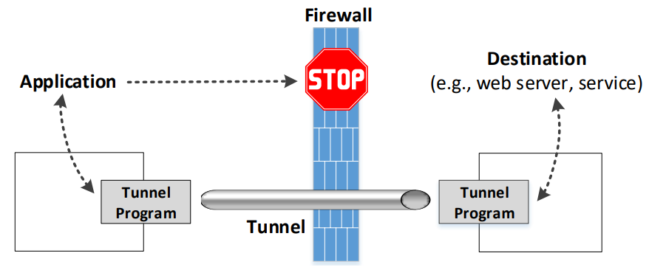
The General Ideas of Tunneling

Slide 4
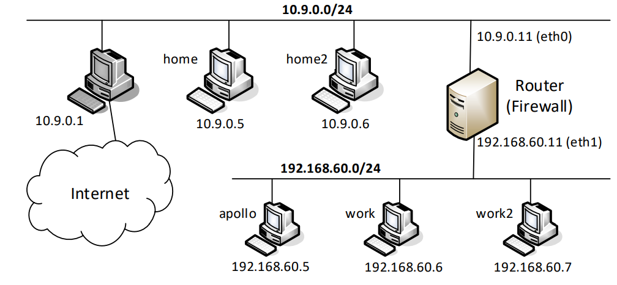
Experiment Setup: Network

Slide 5
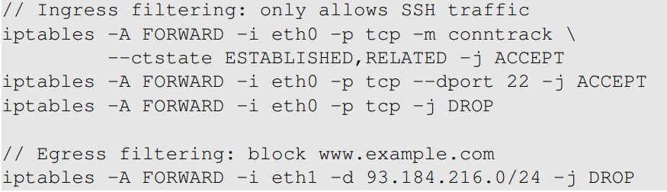
Setup: Firewall Rules
On Router

Slide 6
VPN Tunneling

Slide 7
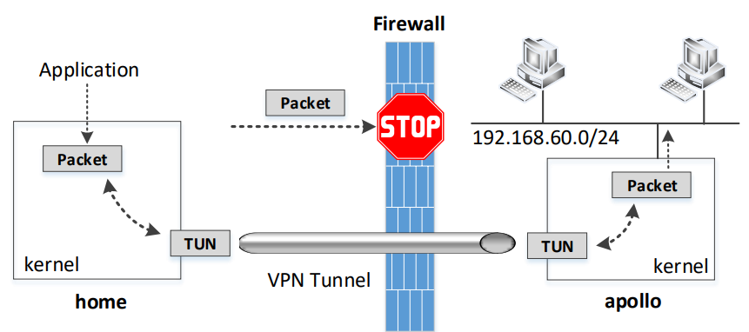
Bypassing Ingress Firewall Using VPN

Slide 8
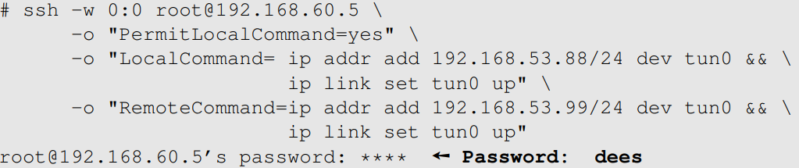
Set Up A VPN Tunnel
Client: Home
Server: Apollo
Run it on client

Slide 9
Configure the Client and Server
Client: Redirect packets
Server: Set up NAT
This is important for the traffic coming from the TUN interface, because their source IP address will be 192.168.53.88
The reply from hosts in 192.168.60.0/24 will be sent to 192.168.53.88, which will not come to the VPN server, unless we change the routing tables on all the hosts in the 192.168.60.0/24 network

Slide 10
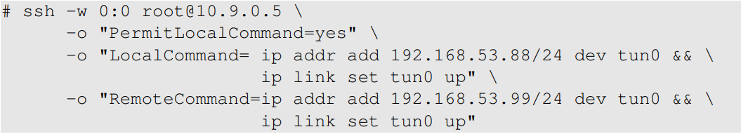
Bypassing Egress Firewall Using VPN
Client: Apollo
access to www.example.com is blocked by the firewall
Server: Home
Run it on client

Slide 11
Configure Client and Server
Client:
Server: Set up NAT
Virtualbox’s NAT server knows nothing about the 192.168.53.0/24 network, because this is the one that we create internally for our TUN interface, and Virtualbox has no idea how to route to this network
We set up our own NAT server on the VPN server, so when packets from 192.168.53.88 go out, their source IP address are always replaced by the VPN server’s IP 10.9.0.5

Slide 12
Configure Other Hosts in 192.168.60.0/24
Hosts in 192.168.60.0/24
ip route add 93.184.216.0/24 via 192.168.60.5
We should re-route example.com bound traffic to Apollo so that they can enter the VPN tunnel
On Apollo:
iptables -t nat -A POSTROUTING -j MASQUERADE -o tun0
Without doing this, the return packets will not go through the VPN tunnel. Instead, they will be directly given by the host VM to the hosts on the 192.168.60.0/24, because the host VM is also attached to this network

Slide 13
Port forwarding

Slide 14
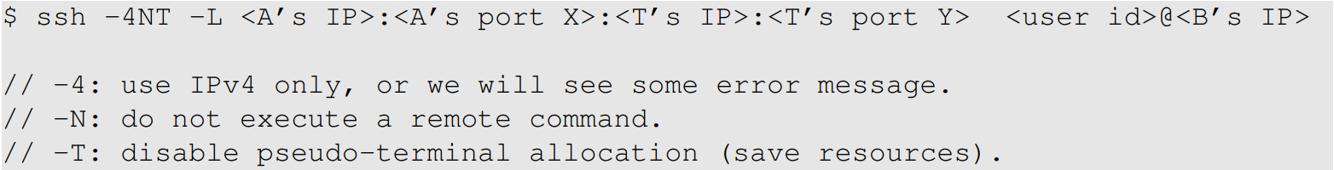
SSH Port Forwarding
Regarding A’s IP, typically we use 0.0.0.0, indicating that our port forwarding will listen to the connection from all the interfaces on A
If we want to limit the connection to the loopback interface, so only the program on the local host can use this port forwarding, we can use 127.0.0.1:<port> or simply omit the IP address (the default IP address is 127.0.0.1)

Slide 15
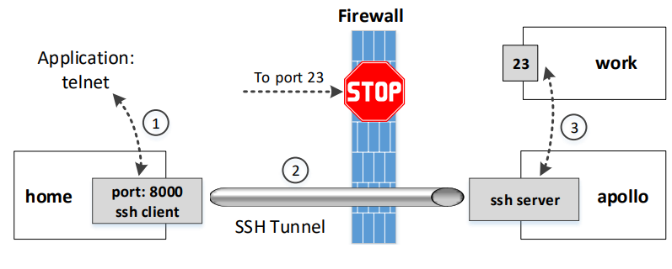
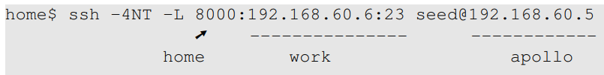
Evading Ingress Firewall
We want to access “work” from “home”
Notes:
-4: use IPv4 only, or we will see some error message.
-N: do not execute a remote command.
-T: disable pseudo-terminal allocation (save resources).

Slide 16
Comparison with VPN
VPN tunnels are built on top of the network layer or link layer. They rely on the routing or bridging to get packets from the application, as well as to release the packets to its final destination. Routing and bridging are transparent to the application. Requires the root privilege
Port forwarding tunnels are built upon the transport layer. For an application to send data to the tunnel program, the application needs to directly communicate with the tunnel program, and thus this type of tunnel is not transparent. Does not require root privilege

Slide 17

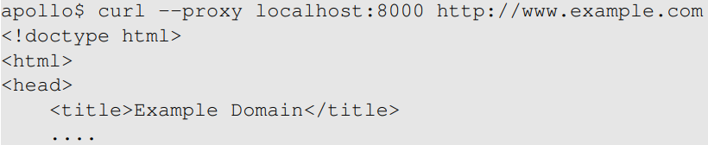
Evading Egress Firewalls
Create the tunnel
Access the blocked site (www.example.com)

Slide 18
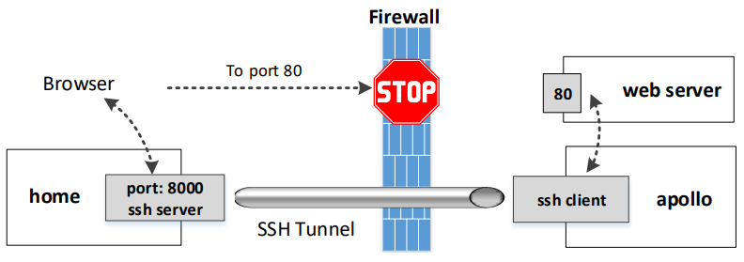

Reverse SSH Tunneling
Port forwarding from Server to Client (reverse)
SSH Server

Slide 19
Dynamic Port forwarding and SOCKS Proxy

Slide 20
Dynamic Port Forwarding
Static port forwarding
Destinations are fixed
One tunnel for each destination
Dynamic port forwarding
Destinations are NOT fixed
One tunnel for many destinations
Therefore, typically called Proxy

Slide 21

An Experiment
Create the tunnel
Use localhost:9000 as proxy

Slide 22
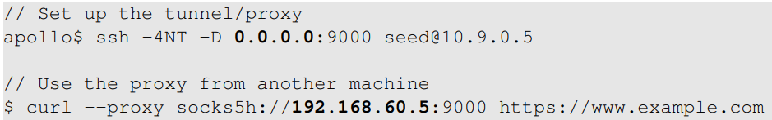
Use Another Host As Proxy
Apollo’s IP address: 192.168.60.5

Slide 23
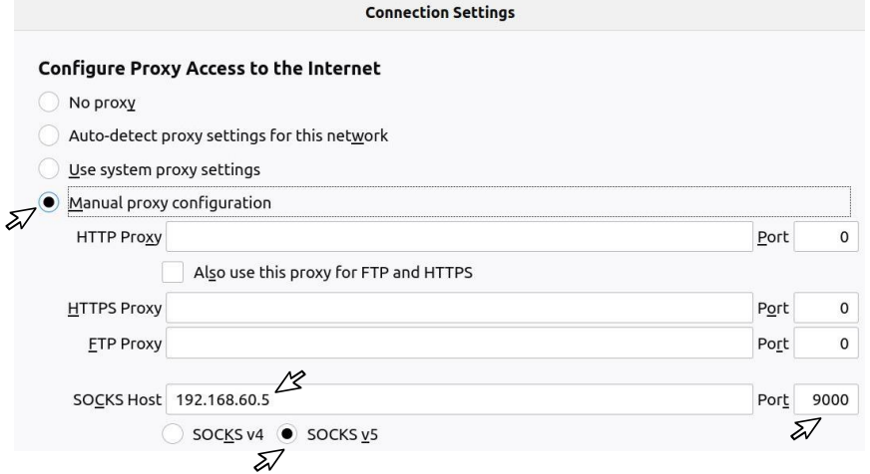
Configure Browser to Use Proxy

Slide 24
The SOCKS Protocol
How does the dynamic port forwarding work?
The destination is not specified
The client must tell the proxy the destination information
The client and proxy use a protocol for that purpose
SOCKS protocol
Socket secure, version 5 (SOCKS5)
The client must have a native support of SOCKS protocol

Slide 25
SOCKs
SOCKS, which stands for Socket Secure, is a network protocol that facilitates communication with servers through a firewall by routing network traffic to the actual server on behalf of a client
A SOCKS proxy server creates a TCP/UDP connection to another server behind the firewall on the client’s behalf, then exchanges network packets between the client and the actual server
SOCKS is a layer 5 (session layer) protocol. It can handle several request types, including HTTP, HTTPS, POP3, SMTP and FTP

Slide 26
SOCKs4 vs SOCKs5
There are only two versions: SOCKs4 and SOCKs5
SOCKs4 doesn’t support authentication, while SOCKs5 supports a variety of authentication methods; and
SOCKs4 doesn’t support UDP proxies, while SOCKs5 does
SOCKs5 proxy is more secure because it establishes a full TCP connection with authentication and uses the Secure Shell (SSH) encrypted tunneling method to relay the traffic

Slide 27


Implement a SOCKS Client: Setup
Start a server: we will access it via a proxy
Start a proxy on apollo

Slide 28
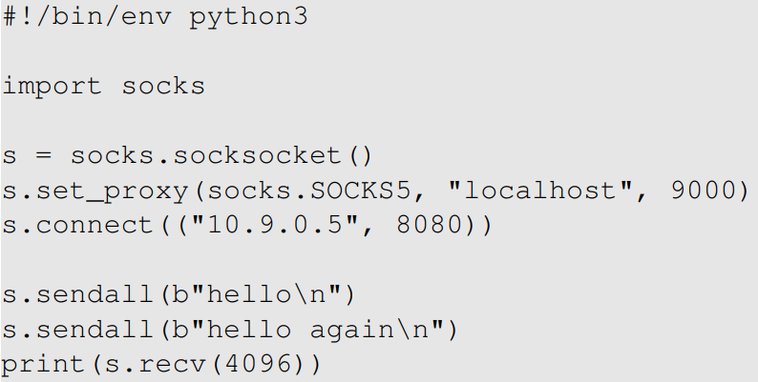
The SOCKS5 Client Program
Proxy
Target

Slide 29
What Happens Between Client and Proxy
Client and Proxy establish a TCP connection
Using the TCP connection, Client and Proxy initiate the SOCKS protocol.
Client tells Proxy the destination of the port forwarding (10.9.0.5:8080).
The port forwarding setup is complete
Proxy forwards the traffic from one end of the tunnel to the other end, from where the data will be further forwarded to the final destination (10.9.0.5:8080)

Slide 30
SOCKS5 Proxy vs. VPN
Both are widely used to create tunnel
Bypassing firewall
Protecting communication
Properties | SOCKS5 | VPN
Transparency | Not | Yes
Setup | Easy | More difficult
Application-specific | Each tunnel is tied to one client | Tunnel can be shared by many clients
Encryption | Depends | Yes

